Slide 1

Recommendation System for Movies
An analysis of Movie lens Data

Slide 2
Topic Overview
Problem
Dataset
Analysis and Result
Machine Learning
Conclusion

Slide 3
Why we need Recommendation system?
It has been estimated that there are approximately 500,000 movies currently in existence.
This situation creates `selection pressure’ on individual movies, as not all movies are equally popular.
The audience will not be spending their time watching every movie available to them, they will pick randomly something to watch.
If a person picks a movie and does not enjoy it there will be no positive word-of-mouth.
This doesn’t necessarily mean the movie was bad, it might mean it was not interesting to that individual. This is where the recommendation system is helpful.
Recommendation system helps the user find items of their interest and Helps the item provider to deliver their items to the right user.
It increases revenues for business through increased consumption.

Slide 4
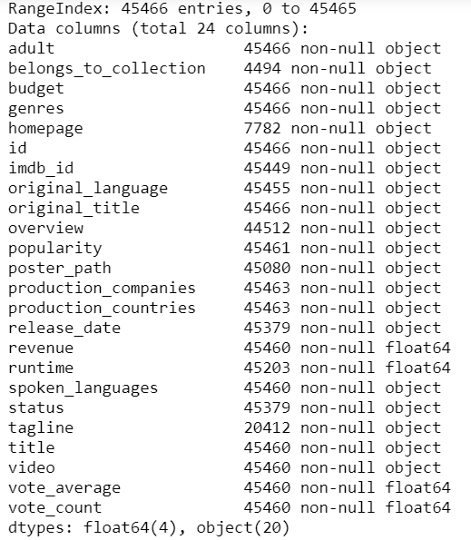
Dataset
metadata for all 45,000 movies listed in the Full Movie Lens Dataset.
The dataset consists of movies released on or before July 2017.
This dataset also has files containing 26 million ratings from 270,000 users for all 45,000 movies.

Slide 5
Data Wrangling
The dataset has a record of 45466 movies with 24 columns(features).Dropped columns with more than 50% of its total data with null values.
Converted budget feature into a numeric variable and replaced all the non-numeric values with NaN.
Extracted feature "Release Year" from "Release Date." "Release Year" is the year in which the movie was released.
Calculated the Net Profit/Loss using features "Revenue" and "budget.“
Dropped features like adult, id, original_title, poster_path, video as does not provide useful information.
Converted vote_count, and vote_average to float type from object.

Slide 6
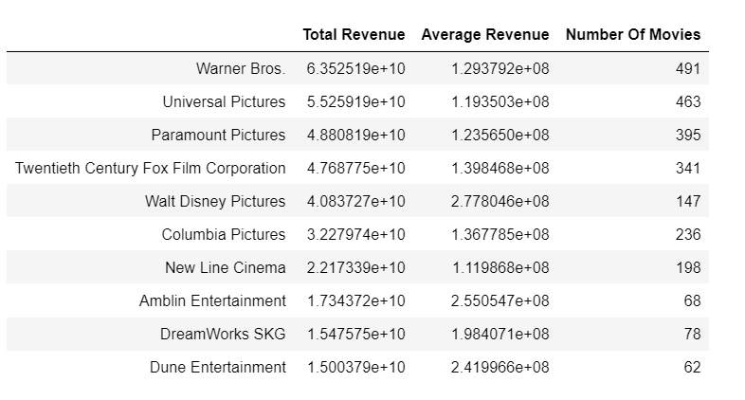
Which Production companies make most money in movie business?
Warner Bros is the highest-earning production company of all time, earning a staggering 63.5 billion dollars from close to 500 movies.
Universal Pictures and Paramount Pictures are the second and the third highest-earning companies with 55 billion dollars and 48 billion dollars in revenue.
As we are aware, Warner Bros and Universal Pictures are bigger studios compared to others on the list.
Thus it would be more appropriate to look at the average revenue of studios. We will consider studios that have produced at least ten movies.

Slide 7
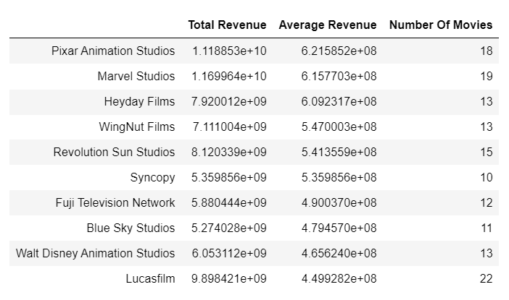
Which Production companies make most money in movie business?
Pixar Animation Studios has produced the most successful movies, on average.
Marvel Studios, with an average gross of 615 million dollars, comes in second.

Slide 8
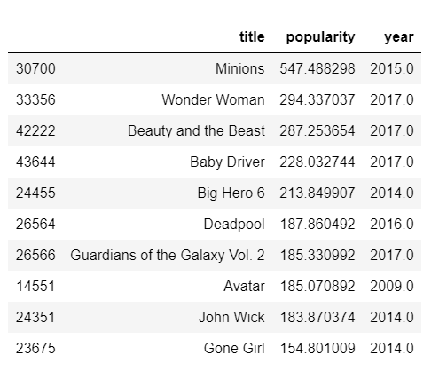
Which movies are more popular?
"Minions" is the most popular movie by the TMDB Popularity Score.
Wonder Woman and Beauty and the Beast come in second and third respectively.

Slide 9
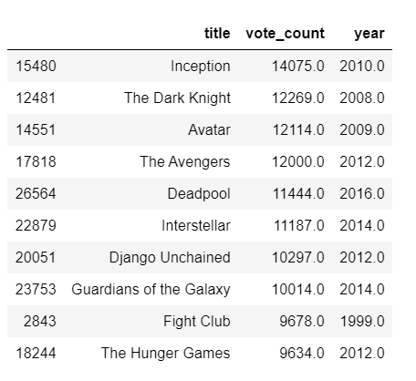
Which movies have been most voted by TMDB voters?
Inception and The Dark Knight, two critically acclaimed movies, are at the top of our chart.
It is interesting to note that Christopher Nolan directed both movies.

Slide 10
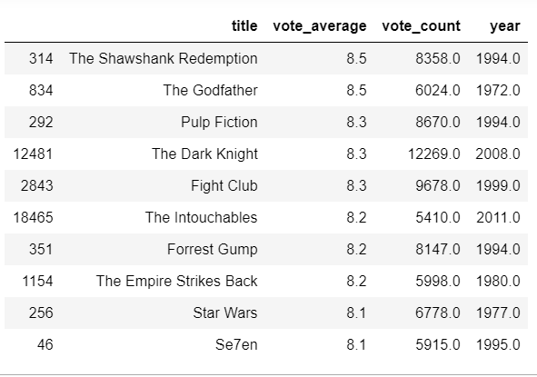
Which movies are most Critically Acclaimed?
We will only consider those movies with more than 5000 votes (similar to IMDB's criteria of 5000 options in selecting its top 250).
The Shawshank Redemption and The Godfather are the two most critically acclaimed movies in the TMDB Database.

Slide 11
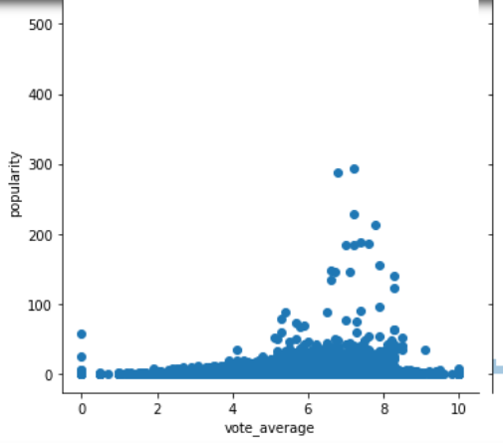
Do popularity and vote average share a tangible relationship?
The Pearson Coefficient of the two quantities, is 0.154, suggesting no definite correlation.
In other words, popularity and vote average and independent quantities.

Slide 12
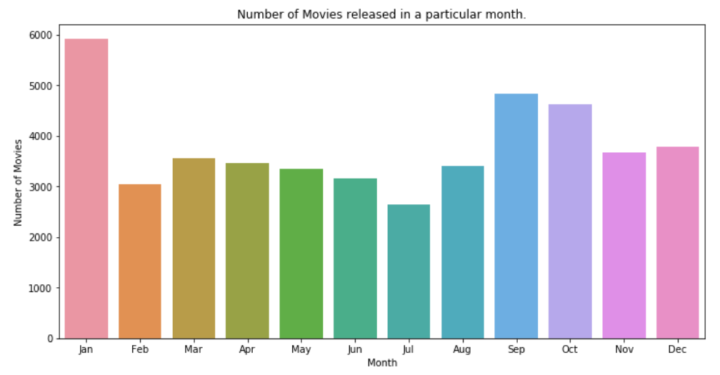
Does Release Dates play a significant role in determining the revenue of a movie?
We will gain insights about release dates in terms of months.
Extracted the month for each movie from release date.
January is the most popular month when it comes to movie releases.
This is also known as the dump month in Hollywood circles when the dozen release subpar movies.

Slide 13
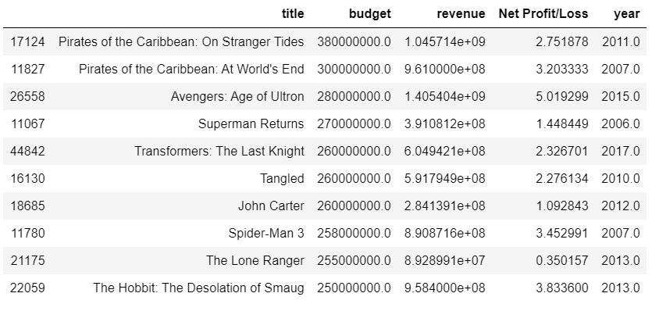
Which are the most expensive movies of all time?
Two Pirates of the Caribbean films occupy the top spots in this list with a staggering budget of over 300 million dollars.
All the top 10 most expensive movies made a profit on their investment except for The Lone Ranger
“The Lone Ranger “ managed to recoup less than 35% of its investment, taking in a paltry 90 million dollars on a 255-million-dollar budget.

Slide 14
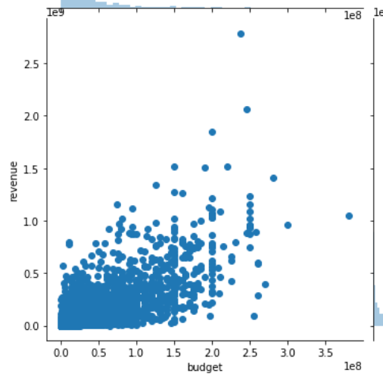
How strong a correlation does the budget hold with the revenue?
A stronger correlation would directly imply more accurate forecasts.
The scatterplot shows a positive correlation between budget and revenue.

Slide 15
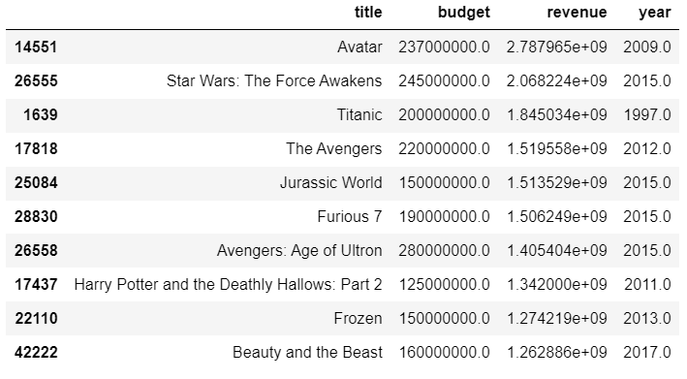
Which are the Highest Grossing Films of All Time?
The world of movies broke the 1-billion-dollar mark in 1997 with the release of Titanic.
It took another 12 years to break the 2-billion-dollar mark with Avatar. James Cameron directed both these movies.
The highest-grossing movie does not necessarily mean the movie made the highest profit of all.

Slide 16
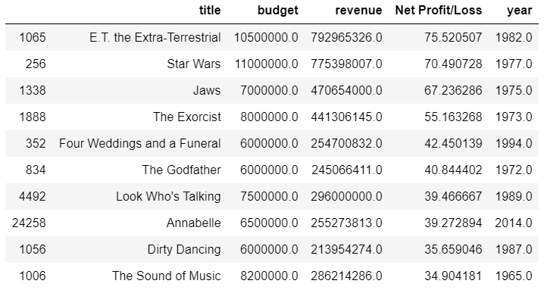
Which are the least and the most successful movies of all time?
Let us check the least and the most successful movies of all time.
we will only consider those movies which have a budget greater than 5 million dollars.
E.T. the Extra-Terrestrial is the most successful movie.
It is interesting to note that most of the successful movies in the top 10 list are released between 1965 - 1989.

Slide 17
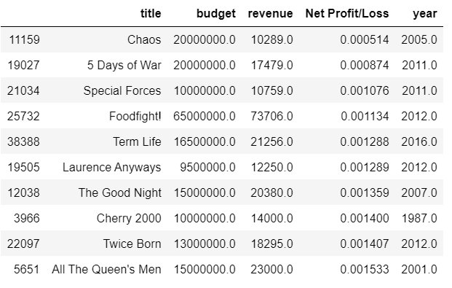
Which are the least and the most successful movies of all time?
Chaos is the least successful movie.
We can observe here that most of the movies listed in top 10 are released between 2000-2012
So is it that older movies were more successful than newer ones?
We cannot certainly say so as these figures have not been adjusted for inflation.

Slide 18
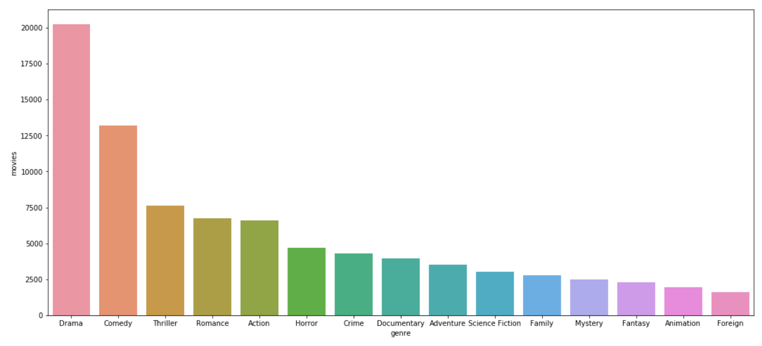
Most commonly occurring genres in movies
TMDB defines 32 different genres for our set of 45,000 movies.
Drama is the most commonly occurring genre, with almost half the movies identifying itself as a drama film.
Comedy comes in at a distant second, with 25% of the movies having adequate humor doses.
Other significant genres represented in the top 10 are Action, Horror, Crime, Mystery, Science Fiction, Animation, and Fantasy.

Slide 19
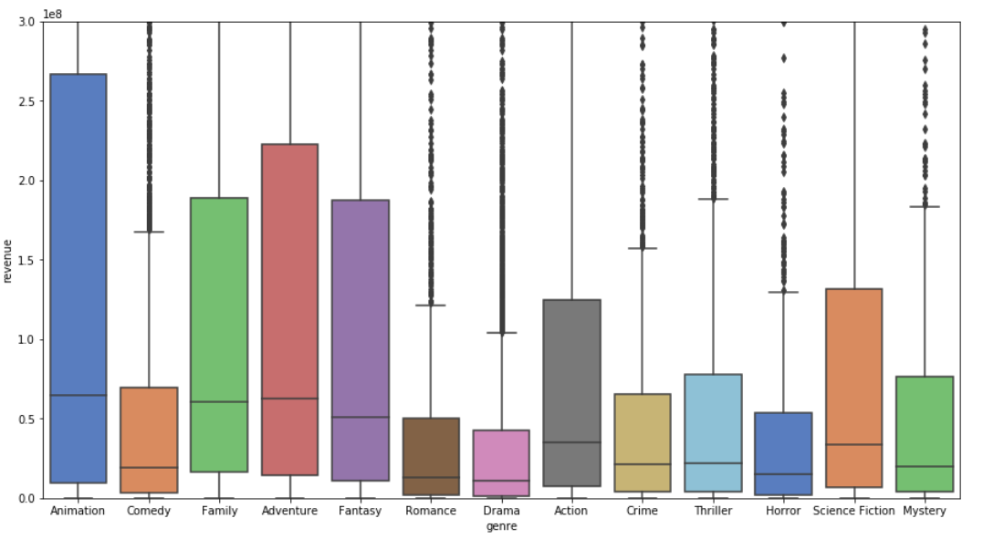
Are some genres more successful than others?
Animation movies have the most extensive 25-75 range and the median revenue among all the genres plotted.
Family and Adventure have the second and third highest median revenue, respectively.
It is surreal to know that Romance and Drama have the lowest median revenue compared to other genres.

Slide 20
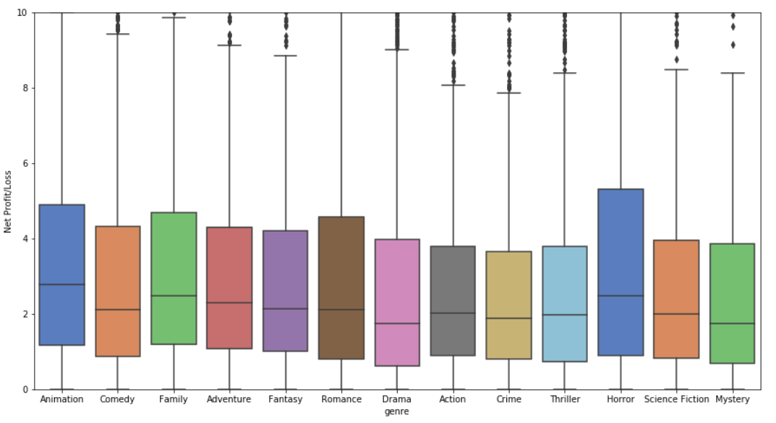
Are some genres more successful than others?
Animation Movies tend to yield the highest returns on average. Horror Movies also tend to be a good yield.

Slide 21
Content-based recommenders:
suggest similar items based on a particular item
This system uses item metadata, such as genre, director, description, actors, etc. for movies, to make these recommendations.
The general idea behind these recommender systems is that if a person likes a particular item, they will also enjoy an item that is similar to it.
And to recommend that, it will make use of the user's past item metadata.

Slide 22
Collaborative Filtering recommenders:
They try to predict the rating or preference that a user would give an item-based on past ratings and other users' preferences.
Collaborative filters do not require item metadata like its content-based counterparts.

Slide 23
Simple recommender:
The Simple Recommender offers generalized recommendations to every user based on movie popularity and genre.
The basic idea behind this Recommender is that movies with more votes and more positive critic reception will have a higher probability of being liked by the average audience
This model does not give personalized recommendations based on the user.
In simple terms, this is like searching "Top 10 Good romantic movies of all time" in any search engine.
I use the TMDB Ratings to come up with our Top Movies Chart. I will use IMDB's weighted rating formula to construct my chart.

Slide 24
Simple recommender continued..
For a movie to feature in the charts, it must have more votes than at least 80% of the movies on the list.
Therefore, to qualify for the chart, a movie has to have at least 50 votes on TMDB.
We also see that the average rating for a movie on TMDB is 5.244 on a scale of 10, and 9151 Movies qualify to be on our chart.

Slide 25
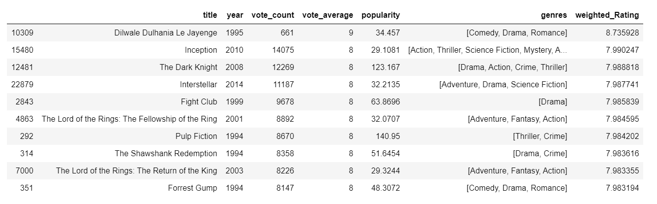
Top 250 high rated movies Chart

Slide 26
Top 250 high rated movies Chart
It is interesting to see three Christopher Nolan Films, Inception, The Dark Knight, and Interstellar, which occur at the top of our chart.
The chart also indicates a strong bias of TMDB Users towards particular genres and directors.

Slide 27
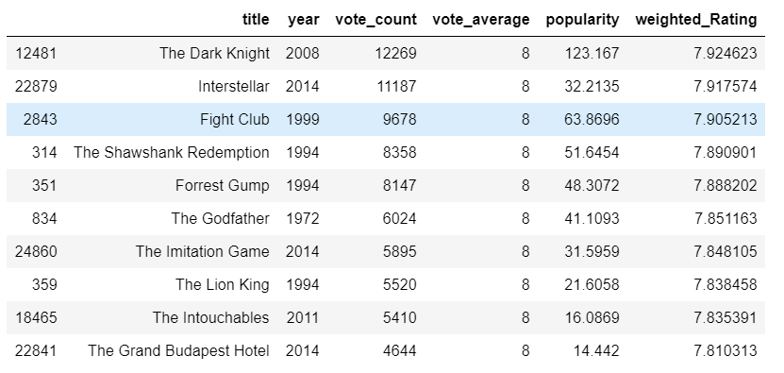
Top 10 drama movies

Slide 28
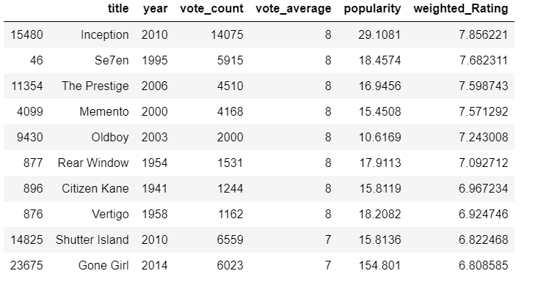
Top 10 Mystery movies

Slide 29
Limitations of simple recommender
It gives the same recommendation to everyone, regardless of the user's taste.
If a person who loves romantic movies (and hates action) were to look at our Top 10 Chart, she/they/he wouldn't probably like most of the movies.
If she/they/he were to go one step further and look at our charts by genre, she/they/he wouldn't still be getting the best recommendations.

Slide 30
Content based recommender
Recommender based on the following metadata: the 3 top actors, the director, related genres, and the movie plot keywords.
In this recommender system, the movie's content ( cast, crew, keyword, etc.) is used to find its similarity with other movies.
Then the movies that are most likely to be similar are recommended.
As Required data was present in the form of "stringified" lists, I converted it into a safe and usable structure.
I also converted the names and keyword instances into lowercase and stripped all the spaces between them.
This is done so that our vectorizer doesn't count the Jennifer of "Jennifer Garner" and "Jennifer Aniston" as the same.

Slide 31
Content based recommender
I have Mentioned Director 3 times to give it more weight relative to the entire cast.
I created a "metadata soup," a string containing all the metadata that we want to feed to our vectorizer (namely actors, director, and keywords).
To use textual data for predictive modeling, the text must be parsed to remove certain words – this process is called tokenization.
These words need to be encoded as integers, or floating-point values, for inputs in machine learning algorithms. This process is called feature extraction (or vectorization).
I have used CountVectorizer() for this process.

Slide 32
Content based recommender
Using cosine similarity, I am calculating a numeric quantity that denotes the similarity between two movies.
I used the cosine similarity score since it is independent of magnitude and is relatively easy and fast to calculate.

Slide 33
Algorithm for Content based recommender
Get the index of the movie given its title.
Get the list of cosine similarity scores for that particular movie with all movies.
Convert it into a list of tuples where the first element is its position, and the second is the similarity score.
Sort the list mentioned above of tuples based on the similarity scores, the second element.
Get the top 10 elements of this list. Ignore the first element as it refers to self (the movie most similar to a particular movie is the movie itself).
Return the titles corresponding to the indices of the top elements

Slide 34
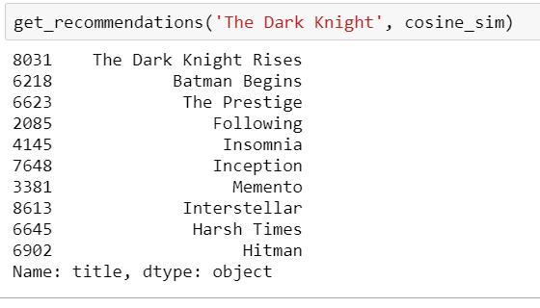
Content based recommender-output
The function get_recommendations() will take the movie title as the first input argument and the cosine_sim matrix as your second input argument.
For this, we need a reverse mapping of movie titles and Data Frame indices.
we need a mechanism to identify the index of a movie in our metadata Data Frame, given its title.
The recommendations seem to have recognized other Christopher Nolan movies (due to the high weightage given to the director) and put them as top recommendations.

Slide 35
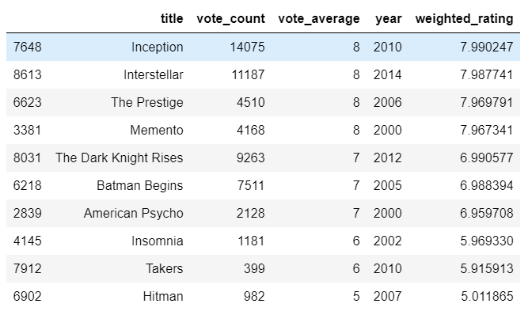
Content based recommender-using vote count
I took the top 25 movies based on similarity scores and calculated the 60th percentile movie's vote.
Using this value of, we will calculate the weighted rating of each movie.

Slide 36
Collaborative filter-based recommender
To better interpret the data, we first pivot the data frame to have userId as rows and movieId as columns, filling the null values with 0.0.
I have used the scipy library in Python to implement algorithms like Singular Value Decomposition (SVD) to give great recommendations and build a function that uses factorized matrices to recommend movies to a user user_id.
This function evaluates all the movies and their ratings, rated so far by the user(implying the user watched this movie) and recommends other movies in the dataset by predicting its rating.

Slide 37

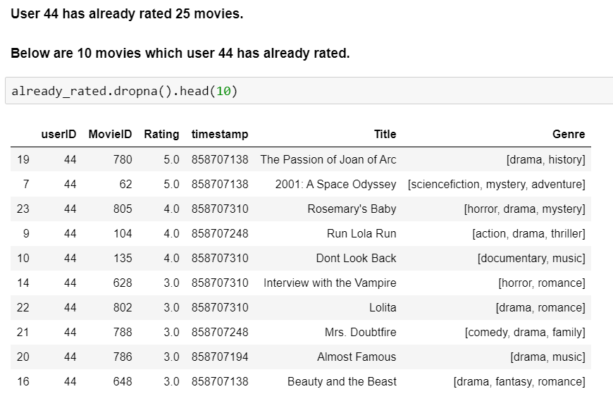
Collaborative filter-based recommender

Slide 38
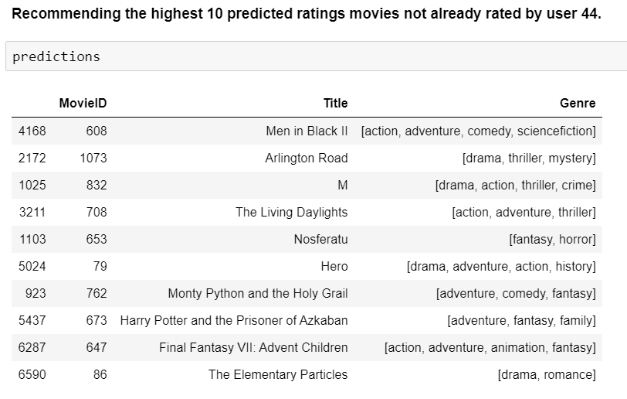
Collaborative filter-based recommender

Slide 39
Conclusion
Simple Recommender: This system used overall TMDB Vote Count and Vote Averages to build Top Movies Charts, in general, and for a specific genre. The IMDB Weighted Rating System was used to calculate ratings on which the sorting was finally performed. This Recommender does not account for any user preference.
Content-Based Recommender: I built a that took movie metadata such as cast, crew, genre, and keywords to make predictions. We also devised a simple filter to provide further preference to movies with more votes and higher ratings. However, It is only capable of suggesting movies that are close to a particular movie. That is, it is not capable of capturing tastes and providing recommendations across genres.
Collaborative Filtering: We used the powerful Surprise Library to build a collaborative filter based on single value decomposition. One con about this Recommender is that it doesn't necessarily succeed in automatically matching content to one's preferences. These collaborative filtering systems require a substantial number of users to rate a new item before that item can be recommended.

Slide 40
Recommendation
We can use content-based recommender to suggest movies based on a particular movie user watched.
Collaborative filter-based recommender would be advisable to provide recommendations to user not only based on their watched movie list but also their likings towards it.
With a hybrid model that brings together ideas from content and collaborative filtering to build an engine, we may be able to give better movie suggestions to a particular user in the future.

Slide 41


Thank You

